Slide 1
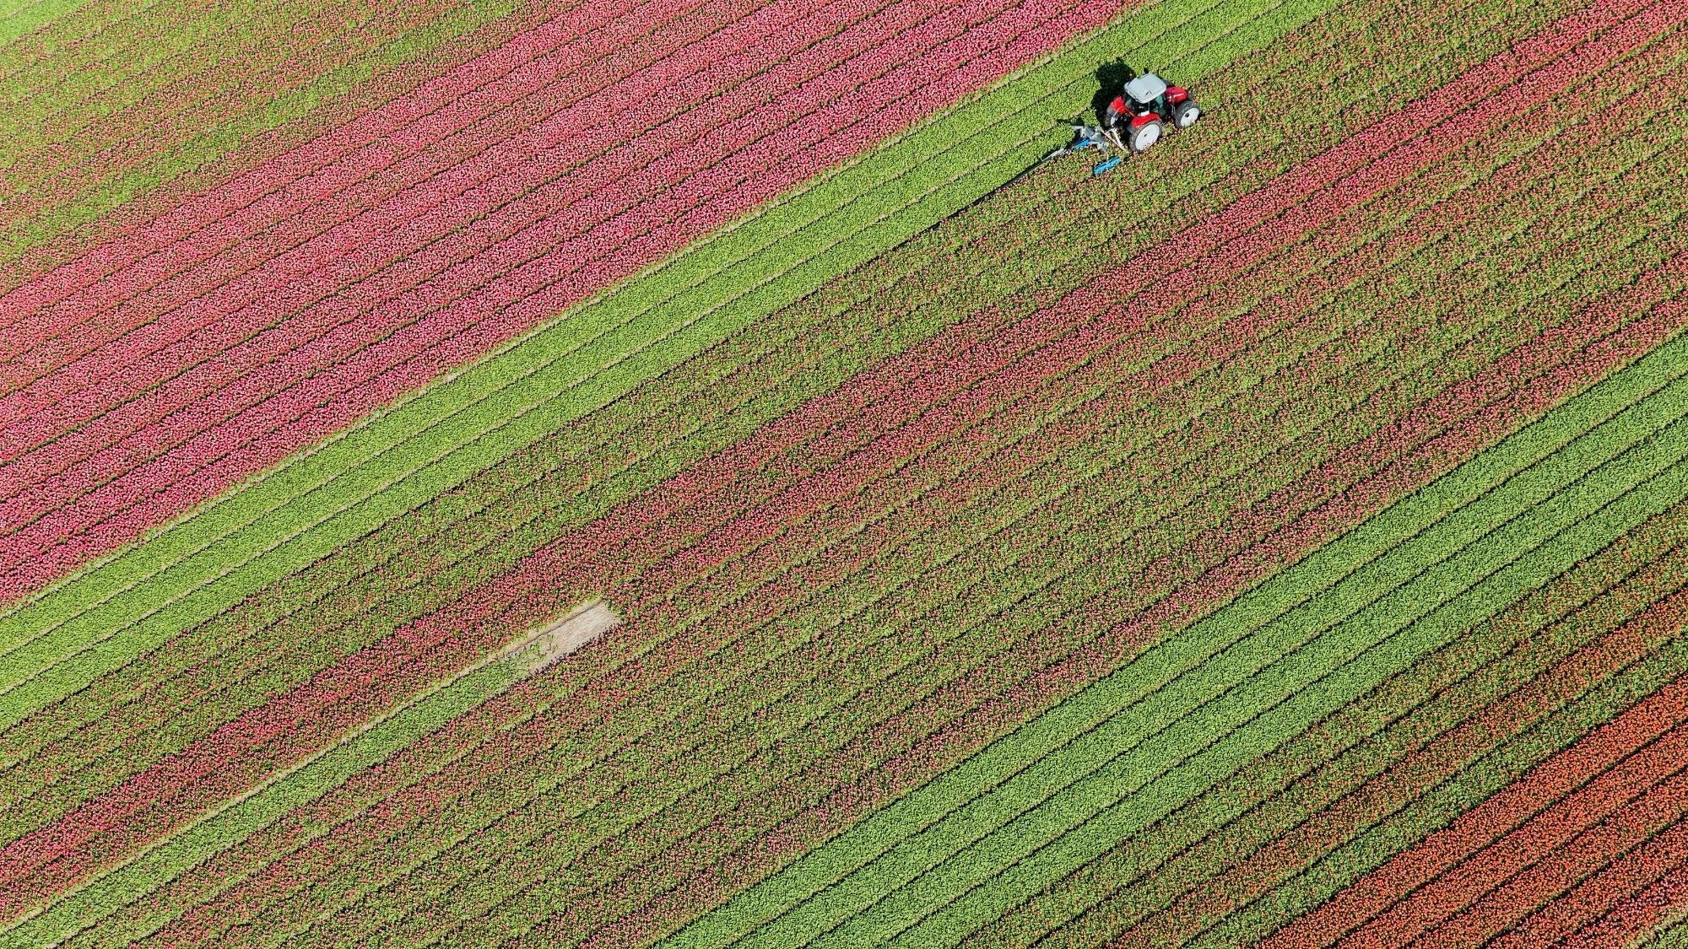

Smart Agriculture Using IoT and ML Presented To: Dr. Priyanka Bagade Assistant Professor, IIK
Notes:
India is a country of farmers in which 1/3 of the population depends on agriculture production

Slide 2
Agenda
Introduction
Challenges Government Initiative Problem statement Related work Methods and deliverables

Slide 3
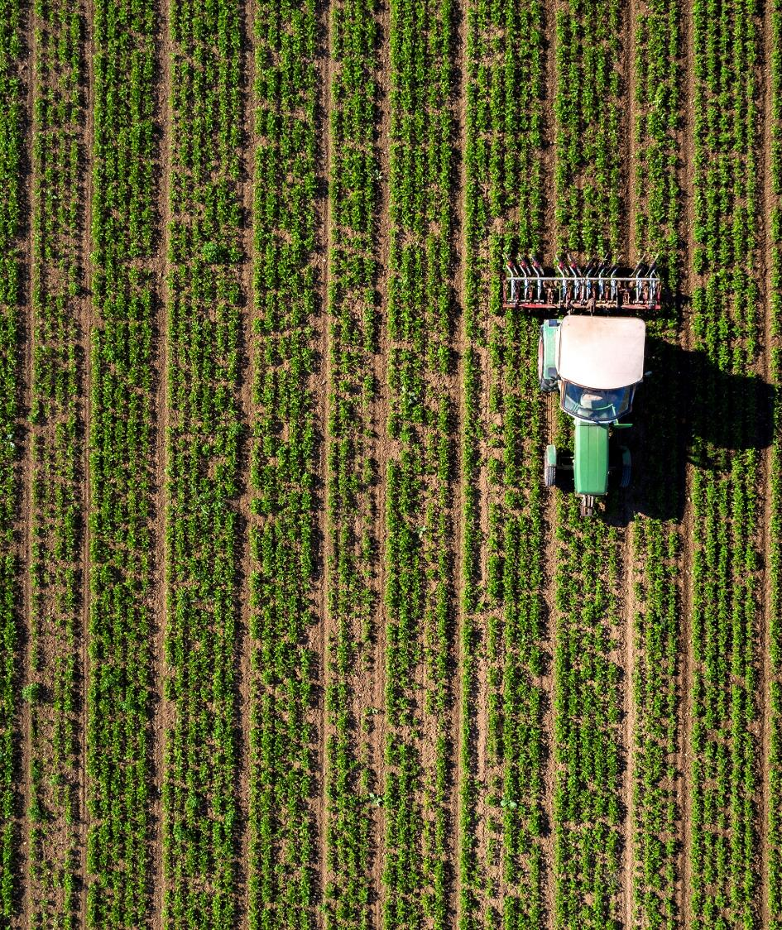
Soil Fertility
It is the capacity of a soil to supply plant nutrients in adequate amounts to facilitate optimum growth and obtaining the yield potential of a crop. Plant Nutrients : Although plants absorb a large number of elements, all of them are not essential for the growth of crops
Major nutrients: Carbon, hydrogen and oxygen, Nitrogen, phosphorus, potassium.
Secondary nutrients: Calcium, magnesium, sulphur
Micronutrients : lron, manganese, boron, zinc,
copper, molybdenum and chlorine. When these elements are not available to the plant in quantities optimum for growth, the quantity and quality of yield is affected

Slide 4
Prevention Is Better than Cure
Hidden hunger :There are no visual symptoms of deficiency but the plant is not producing at its capacity
When the plant reaches the level where symptoms appear, the yield may already have been greatly reduced.

Slide 5
Excess Fertilizer
Eutrophication: a process that occurs when a body of water becomes enriched with nutrients, which causes damage to Aquatic Life Cycle
Ex: Bathinda-Bikaner train(Punjab's cancer train),
Wastage of Resources(Water, Electricity…),
Subsidy on Fertilizers.

Slide 6
Soil Testing
One of the objective of soil testing is to sort out the nutrients deficiency in soil
Basic aim of the soil testing is to assess the fertility status of the soils so as the recommendations for the fertilizer use
GoI Initiative : “Soil Health card” a lab based approach

Slide 7

Challenges with Lab based approach
There is less number of laboratories in the states of country for testing the Soil parameters
Lab testing often takes several days to weeks before results are available. This delay can hinder timely decision-making, especially for seasonal crops that require immediate attention.
Soil health reports from labs often contain detailed, technical data that can be difficult for farmers to interpret without expert guidance.
For farmers far from testing facilities, each visit may require a considerable amount of travel time and effort.

Slide 8
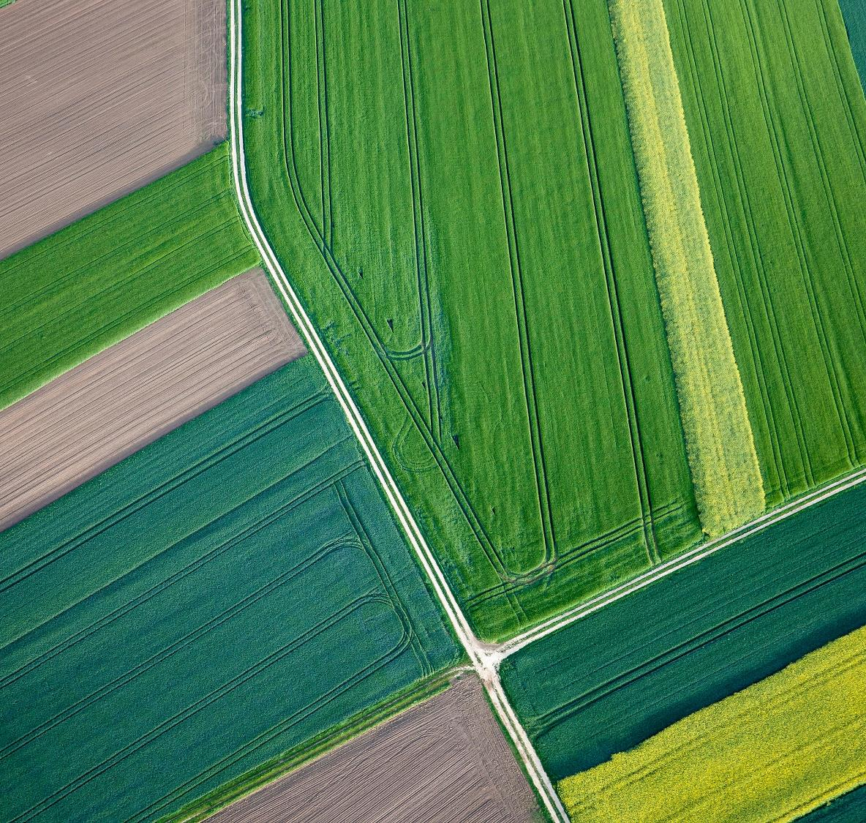
Digital soil health monitoring
Using IoT and Machine Learning

Slide 9
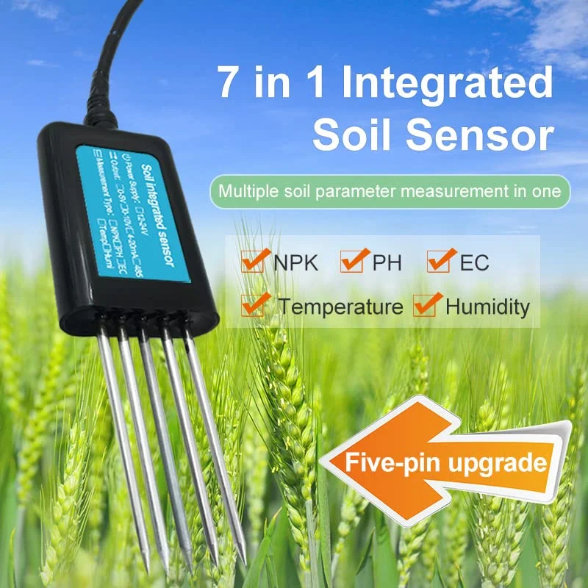
Problem Statement
To deliver real time and continuous interval-based monitoring and analysis of soil test report to enhance crop yield
Measure using WSN
Store using server
Analyze and optimization using Machine learning
Recommend Required fertilizer

Slide 10
Related work
Research Paper | Observations | Sensors Used | ML Algorithms | Limitations
1)A Self-Powered, Real-Time, LoRaWAN IoT-Based Soil Health Monitoring System | LoRaWan Based approach. Temperature,Humidity,Co2 is measured. Energy Harvesting method like solar panel is used. | Soil moisture, PH,Temperature EC, Co2 | - | No analysing method of collected data is proposed . Just graphical representation of data. Not all nutrients is considered.
2)A Cloud based Soil health Digitalization and Monitoring Technique for Optimum Resource Utilization in Smart Farming | Cloud storage of data for better accessibility. Test tube based method for NPK measurment | Soil Moisture,NPK | - | Raw data is stored in cloud no analysis method is proposed. Smart sensing methods for npk is not used .

Slide 11
Related work
Research Paper | Observations | Sensors Used | ML Algorithms | Limitations
3)Machine learning enabled IoT system for soil nutrients monitoring and crop recommendation | Used LoRaWAN as communication protocol. Considered all major nutrients. Real time monitoring | Moisture, pH, NPK, Temperature, Humidity | Random Forest, Logistic Regression, LGBM, Neural Networks | No Energy harvesting method is used. Nutrients cycle of crop is not considered. Soil type is not considered
4)IoT-Enabled Soil Nutrient Analysis and Crop Recommendation Model for Precision Agriculture | Test tube based approach using IOT. Used for crop recommendation | Soil Temperature, Moisture, Water Level,pH,NPK | Multi-class SVM with FFO | No real time and continuous monitoring. Used only at time planting

Slide 12
Related work
Research Paper | Observations | Sensors Used | ML Algorithms | Limitations
5)Automation in Agriculture and IoT | monitoring PH, Temparature , Humidity. | PH,temperature, Humidity | - | No data storage No explanation of analysis method . Not used cloud based approach to access data from anywhere
6)IoT and GIS Integration for Real-Time Monitoring of Soil Health and Nutrient Status | Integration geographic Information System. All major nutrients Is considered | Moisture,pH, Temperature, Humidity | - | Understanding numbers is difficult for farmers. No analysis or recommendation from stored data

Slide 13
Related work
Research Paper | Observations | Sensors Used | ML Algorithms | Limitations
7)IoT-Based-Real-Time Monitoring System for pression agriculture | Automatic irrigation Based on Moisture,Low cost | Moisture, temperature, Humidity | - | Only focuses on Irrigation, Limited sensors data
8)IoT for Real-Time Soil Nutrients Monitoring and Fertilizer Recommendation | High Prediction accuracy for fertilizer needs | Moisture,NPK, Temperature, | Random Forest , SVM | Just point based recommendation. Depletion rate of nutrients is not considered
9)IoT-Based Soil Health Digitalisation and Monitoring Techniques | Real time soil Health Monitoring | Moisture, NPK, Temperature | - | No analysis using ML

Slide 14
Related work
Research Paper | Observations | Sensors Used | ML Algorithms | Limitations
10) Soil moisture monitoring using IoT enabled arduino sensors with neural networks for improving soil management for farmers and predict seasonal rainfall for planning future harvest in North Karnataka - India | Measuring soil moisture using IOT. neural networks is used for analysis purpose | Soil Moisture | Neural Networks | Soil management also includes pH, nutruents ,temperature are completely ignored

Slide 15
How different ..?
Sustainable Power Source: Solar cells can harness sunlight to power the rechargeable battery to power various sensors and devices used for continuous soil health monitoring, reducing the need for large external power sources.
Nutrient Depletion Tracking: By observing patterns in the decreasing rate of soil nutrients, energy management systems can optimize sensor usage.
Prior Information and Predictive Maintenance: Energy management systems can predict when nutrient levels will drop below critical thresholds. By providing prior information to the farmer.
Reduced Sensor On-Time: With smart energy management, sensors can reduce their active on-time, gathering data at optimal intervals rather than continuously

Slide 16
Optimizing Machine Learning Models for IoT-Based Smart Agriculture Systems
Adaptive Sensor Scheduling: Instead of keeping the IoT devices operational 24x7, use ML algorithms like time series forecasting learning or anomaly detection to predict the most critical periods for sensor data collection. Based on historical patterns of crop growth, environmental conditions, and soil nutrient levels, sensors can be activated at the most optimal times rather than continuously, which would significantly save energy and extend the lifetime of IoT devices.
Federated Learning for Decentralized Training:
Since soil and weather conditions can vary significantly across regions, we will use the concept of federated learning where each Dataset pictured as a local node trains a local model on-site and shares only the model updates, not the raw data, with a central server. This reduces network usage, conserves energy, and maintains data privacy while still benefiting from a centralized model.[Optimization for Research paper 2]

Slide 17
Federated Learning
This approach that allows each IoT node (sensor or device considered as dataset for simulations) to train a local model using its own data.
Each crop dataset is treated as a simulated local node, independently filtered using tiny ML model and processed.
Machine learning models filter and extract only the most important data, minimizing unnecessary information.
The results are aggregated into a central model, improving generalization across multiple crops.
Training on smaller datasets speeds up the process and conserves resources.
Transfer learning between crops allows the reuse of knowledge, further optimizing training time and accuracy.

Slide 18
Time-series forecasting model
Goal: Predict when IoT-generated features (e.g., soil moisture, temperature) will fall below a critical threshold.
Challenge: Features decrease over time at varying rates, and predictions must be made based on historical trends.
Assumption: Features are independent of each other.
Ex: Time-Series Data: LSTMs are designed to handle sequential data, making them ideal for predicting future values based on past time-series data.

Slide 19
Time-series forecasting model
Why LSTM((Long Short-Term Memory)?
LSTMs are well-suited for time-series data because they excel in learning from sequential patterns and understanding the temporal relationships between data points over time. This makes them ideal for predicting future values like soil moisture based on historical trends.In contrast, Random Forest treats data points independently, lacking the ability to understand time-related patterns.
How It Works:
The LSTM model learns from historical data collected by IoT sensors. Once trained, the model can predict when critical thresholds (e.g., moisture level below 20%) will be reached. This allows the system to schedule sensor activations only when needed, instead of continuous 24x7 operation.

Slide 20
Key Benefits of LSTM-Based TinyML:
Energy Efficiency:
By implementing TinyML on edge devices, we minimize the computational load. The LSTM model can run directly on low-power IoT devices, ensuring real-time predictions without relying on constant cloud processing.
Threshold-Based Activation:
Once the LSTM predicts a future drop below the critical threshold (e.g., moisture falls below 20% in 12 hours), the system can activate the necessary IoT sensors or irrigation systems. This reduces the need for continuous monitoring and prolongs device battery life.

Slide 21
Flow chart
Sensors : Soil Temperature, Humidity, pH, NPK
Hardware: Arduino, Node MCU, Redberry pi(if needed)
WSN
Edge Computing
Federated Learning: To decrease large data transfer overhead
Server
Cloud server to store and analyse for fertiliser recomondation
Analysis
Time series forecasting: the measure Decay rate, Power saving of IoT devices
Integrate system with the dashboard and user interface
Visualise

Slide 22

Plan with deliverables
Oct 25, 2024: Complete hardware setup (sensors, IoT modules).
Oct 30, 2024: Data collection and preprocessing phase.
Nov 05, 2024: Train machine learning models with collected data.
Nov 08, 2024: Integrate system with the dashboard and user interface
Nov 10, 2024: Testing and refinement.
Nov 11, 2024: Final submission of the project.

Slide 23
Thank You
Vishal Kumar(221201) Abhishek Kumar(220041) Pavan Kumar Ponnaganti(241110606)

